Slide 1
AZ-400.00 Learning Path 02: Implement CI with Azure Pipelines and GitHub Actions

Slide 2
Module 01: Explore Azure Pipelines

Slide 3
Explore the concept of pipelines in DevOps
Build automation and continuous integration
Test automation
Deployment automation
A pipeline enables a constant flow of changes into production via an automated software production line
Pipelines create a repeatable, reliable and incrementally improving process for taking software from concept to customer
Pipelines require infrastructure, this infrastructure will have a direct impact on the effectiveness of the pipeline

Slide 4
Describe Azure Pipelines
1
Azure Pipelines is a cloud service that you can use to automatically build and test your code project and make it available to other users.
2
Works great with Continuous Integration and Continuous Delivery:
Work with any language or platform – Python, Java, PHP, Ruby, C#, and Go
Deploy to different types of targets at the same time
Integrate with Azure deployments – Container registries, virtual machines, Azure services, or any on-premises or cloud target (Microsoft Azure, Google Cloud, or AWS)
Build on Windows, Linux, or macOS machines
Integrate with GitHub
Work with open-source projects
Notes:
Review the Azure Pipelines Key terms in the student manual.

Slide 5
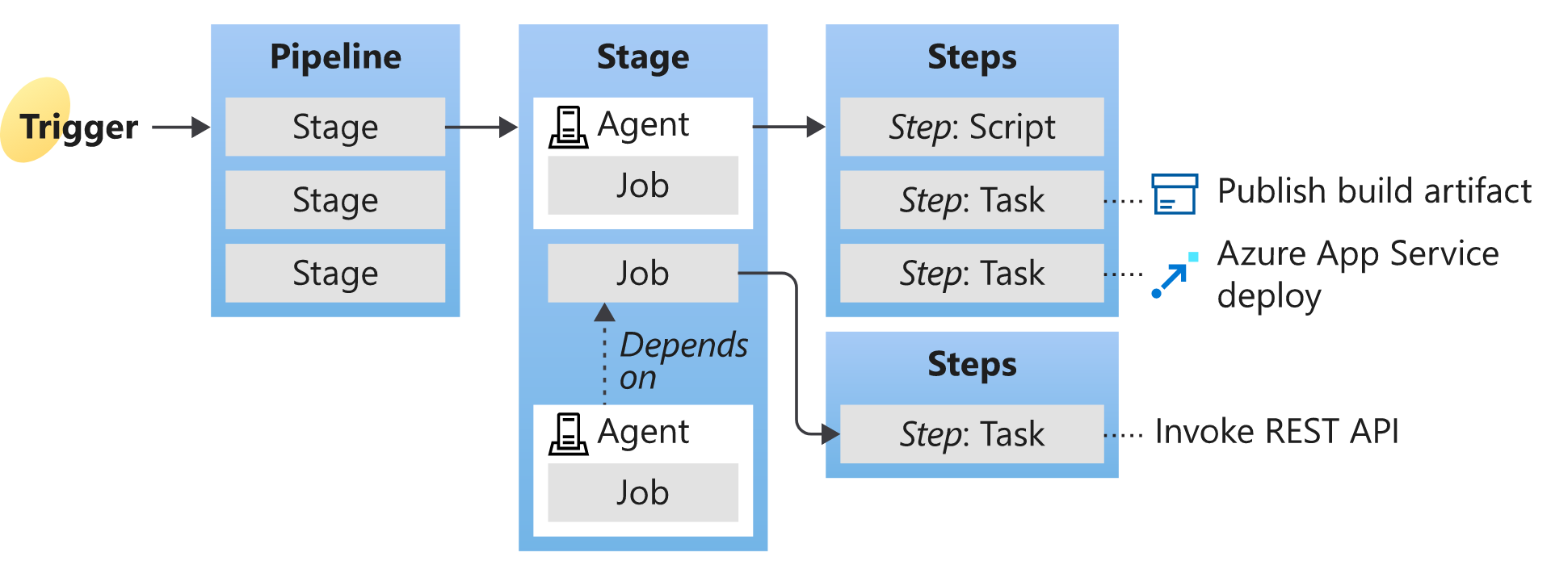
Understand Azure Pipelines key terms
Continuous Delivery (CD)
Continuous Integration (CI)
Deployment target
Notes:
Give a brief description and explain the terms to introduce students to what comes next in the course. We will cover in deeper details in the next Learning Paths.
Understanding the basic terms and parts of Azure Pipelines helps you further explore how it can help you deliver better code more efficiently and reliably.
Agent
When your build or deployment runs, the system begins one or more jobs. An agent is an installable software that runs a build or deployment job.
Artifact
An artifact is a collection of files or packages published by a build. Artifacts are made available for next tasks, such as distribution or deployment.
Build
A build represents one execution of a pipeline. It collects the logs associated with running the steps and the results of running tests.
Continuous delivery
Continuous delivery (CD) (also known as Continuous Deployment) is a process by which code is built, tested, and deployed to one or more test and production stages. Deploying and testing in multiple stages helps drive quality. Continuous integration systems produce deployable artifacts, which include infrastructure and apps. Automated release pipelines consume these artifacts to release new versions and fixes to existing systems. Monitoring and alerting systems constantly run to drive visibility into the entire CD process. This process ensures that errors are caught often and early.
Continuous integration
Continuous integration (CI) is the practice used by development teams to simplify the testing and building of code. CI helps to catch bugs or problems early in the development cycle, making them more accessible and faster to fix. Automated tests and builds are run as part of the CI process. The process can run on a set schedule, whenever code is pushed, or both. Items known as artifacts are produced from CI systems. The continuous delivery release pipelines use them to drive automatic deployments.
Deployment target
A deployment target is a virtual machine, container, web app, or any service used to host the application being developed. A pipeline might deploy the app to one or more deployment targets after the build is completed and tests are run.
Job
A build contains one or more jobs. Most jobs run on an agent. A job represents an execution boundary of a set of steps. All the steps run together on the same agent.
For example, you might build two configurations - x86 and x64. In this case, you have one build and two jobs.
Pipeline
A pipeline defines the continuous integration and deployment process for your app. It's made up of steps called tasks.
It can be thought of as a script that describes how your test, build, and deployment steps are run.
Release
When you use the visual designer, you create a release pipeline also to a build pipeline. A release is a term used to describe one execution of a release pipeline. It's made up of deployments to multiple stages.
Stage
Stages are the primary divisions in a pipeline: "build the app," "run integration tests," and "deploy to user acceptance testing" are good examples of stages.
Task
A task is the building block of a pipeline. For example, a build pipeline might consist of build tasks and test tasks. A release pipeline consists of deployment tasks. Each task runs a specific job in the pipeline.
Trigger
A trigger is something that's set up to tell the pipeline when to run. You can configure a pipeline to run upon a push to a repository at scheduled times or upon completing another build. All these actions are known as triggers.

Slide 6
Module 02: Manage Azure Pipeline agents and pools

Slide 7
Choose between Microsoft-hosted versus self-hosted agents
You generally need at least one agent to build or deploy your project.
An agent is installable software that runs one build or deployment job at a time.
Two types of agents:
1
Microsoft-hosted agents – Maintenance and upgrades are automatically done. Each time a pipeline is run, a fresh virtual machine (instance) is provided. There are time limits on jobs running on these agents.
2
Self-hosted agents – You take care of maintenance and upgrades. Give you more control to install dependent software needed. Can be installed on Linux, macOS, Windows machines, or in a Linux Docker container. There are no time limits on jobs running on these agents.

Slide 8
Explore job types
Four types of jobs:
1
Agent pool jobs – Jobs that run on an agent in an agent pool
2
Container jobs – Jobs that run in a container on an agent in an agent pool
3
Deployment group jobs – Jobs that run on systems in a deployment group
4
Agentless jobs – Jobs that run on the Azure DevOps server (also called Server Jobs)

Slide 9
Introduction to agent pools
Pool A
Pool B
Machine
Machine
Agent
Agent
Agent
Agent
Agent
You can organize agents into agent pools.
An agent pool defines the sharing boundary.
In Azure Pipelines, agent pools are scoped to the Azure DevOps organization; so, you can share an agent pool across projects.
Notes:
Use the student manual for some typical situations where you might want to create agent pools.

Slide 10
Explore predefined agent pool
Image | Purpose | YAML VM Image Label
Windows Server 2022 with Visual Studio 2022 | Windows-2022 | Windows-latest OR windows-2022
Windows Server 2019 with Visual Studio 2019 | Windows-2019 | Windows-2019
Ubuntu 22.04 | Ubuntu-22.04 | Ubuntu-latest OR ubuntu-22.04
Ubuntu 20.04 | Ubuntu-20.04 | Ubuntu-20.04
macOS 14 Sonoma | MacOS-14 | macOS-14
macOS 13 Ventura | MacOS-13 | macOS-13
Notes:
Explain that the list constantly updates; the latest versions should be checked directly from the documentation.
https://learn.microsoft.com/azure/devops/pipelines/agents/hosted
https://learn.microsoft.com/azure/devops/pipelines/agents/agents

Slide 11
Understand typical situations for agent pools
You’re a member of a project and you want to use a set of machines owned by your team for running build and deployment jobs.
You’re a member of the infrastructure team and would like to set up a pool of agents for use in all projects.
You want to share a set of agent machines with multiple projects but not all of them.
Pool A
Pool B
Machine
Machine
Agent
Agent
Agent
Agent
Agent
Queue 1
Queue 2
Queue 1
Team Project Collection A
Team Project Collection B
Team Project A1
Team Project A2
Team Project B1
Job 1
Job 3
Job 1
Job 2
Job 4
Job 2

Slide 12
Communicate with Azure Pipelines
The agent determines which job it needs to run, report the logs, and job status.
Communication is always initiated by the agent.
All the messages from the agent to Azure Pipelines are over HTTPS.
Azure Pipelines
Port 443
Agent on an on-premises machine behind firewall
Agent on a machine in cloud

Slide 13
Communicate to deploy to target servers
Agent must have “line of sight” connectivity to servers.
Microsoft-hosted agent pools, by default, have connectivity to Azure websites and servers running in Azure.
You may need to manually configure connectivity.
Azure Pipelines service
Agent pools
Microsoft-hosted agents
Default
Hosted
1
2
3
4
Network firewall
X
No Line of Sight
Self-hosted agents
Target on-premises stages
1
2
3
4
Server1
Server2
Server3
Server4
Has line of sight, and so can deploy artifacts to these servers

Slide 14
Examine other considerations
1
Authentication
2
Personal Access Tokens
3
Interactive vs Service processes
4
Agent version and upgrades
Notes:
Do self-hosted agents have any performance advantages over Microsoft-hosted agents?
Can I install multiple self-hosted agents on the same machine?

Slide 15
Describe security of agent pools
Roles are defined on each agent pool, and membership in these roles governs what operations you can perform on an agent pool.
Role | Purpose
Reader | Members of this role can view the organization agent pool as well as agents. You typically use this to add operators that are responsible for monitoring the agents and their health.
Service Account | Members of this role can use the organization agent pool to create a project agent pool in a project. If you follow the guidelines above for creating new project agent pools, you typically do not have to add any members here.
Administrator | In addition to all the above permissions, members of this role can register or unregister agents from the organization agent pool. They can also refer to the organization agent pool when creating a project agent pool. Finally, they can also manage membership for all roles of the organization agent pool. The user that created the organization agent pool is automatically added to the Administrator role.

Slide 16
Module 03: Describe pipelines and concurrency

Slide 17
Understand parallel jobs
eShopOnWeb CI Build 102 (main)
1
eShopOnWeb Release 11
2
5
eShopOnWeb CI Build 101 (feature)
3
4
Queued build waiting for pipeline
Build running
Release waiting for pipeline
Release running
Release waiting for approval
This is a simple example of a Microsoft-hosted parallel job.
Users can collectively run only one build or release job at a time; additional jobs are queued.
A release consumes a parallel job only when it’s being actively deployed to a stage.

Slide 18
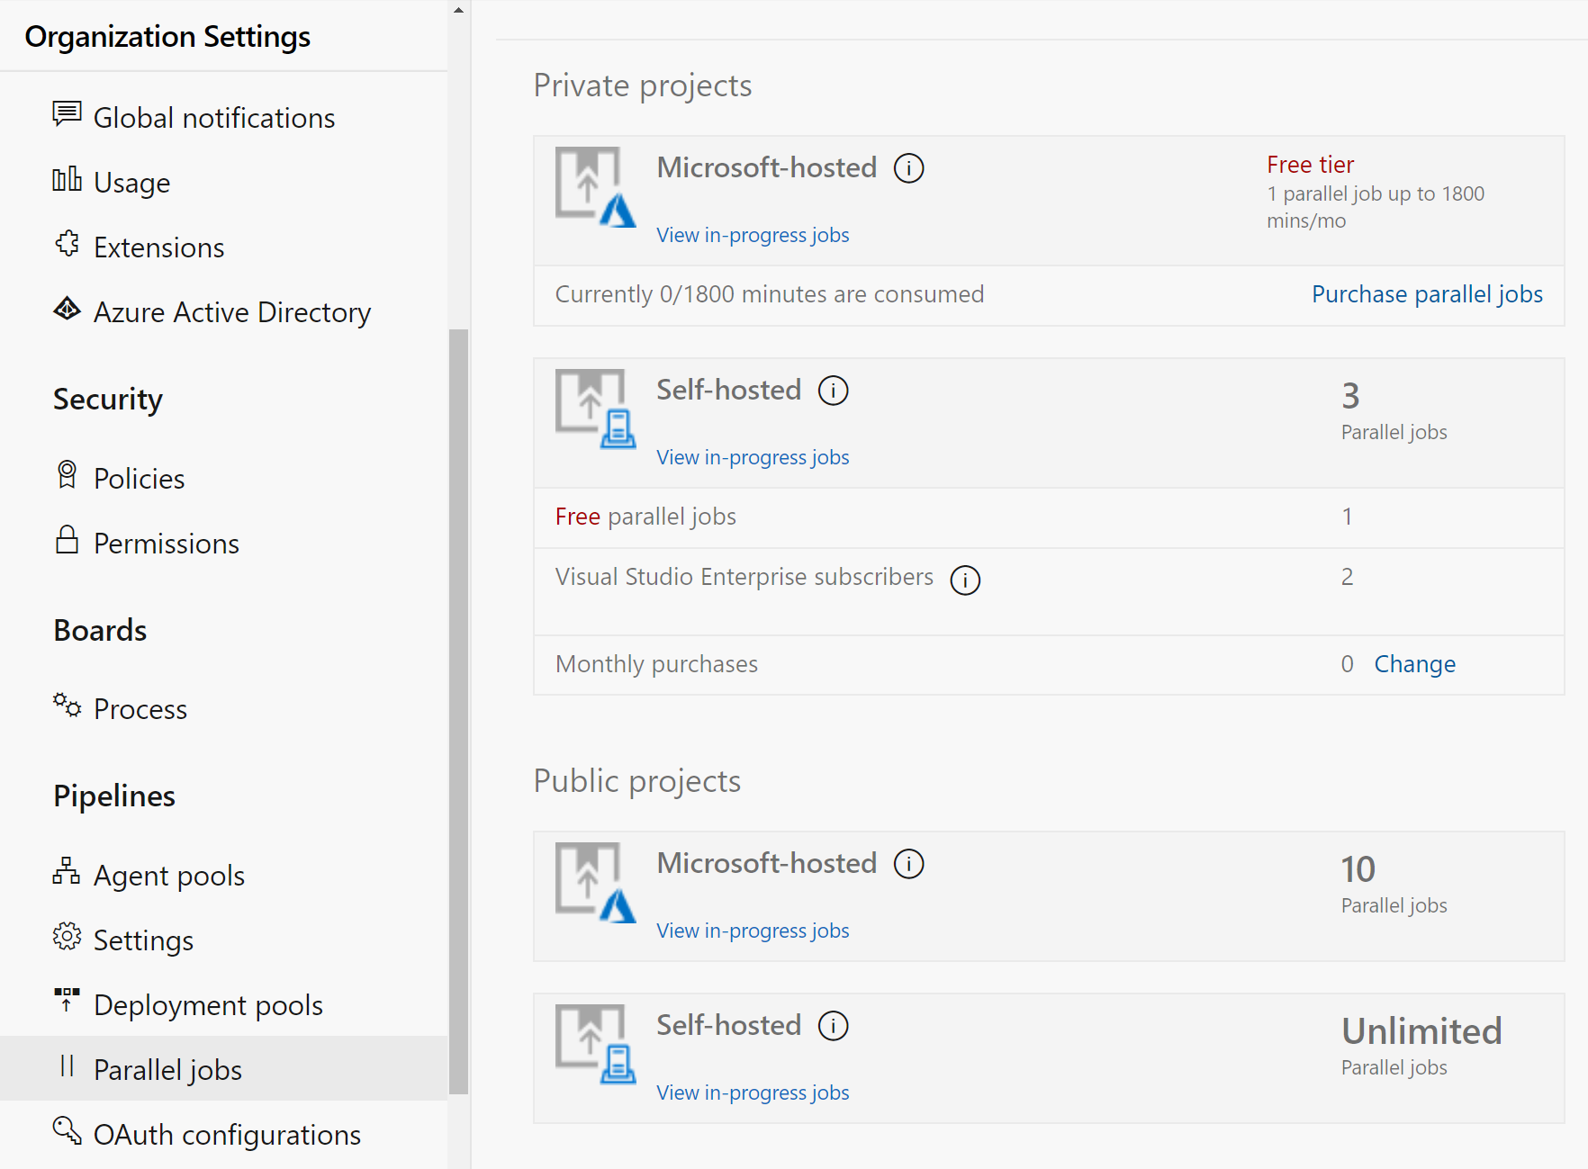
Estimate parallel jobs
Determine how many parallel jobs you need.
Simple estimates vs Detailed estimates
You can display all the builds and releases.
Parallel jobs are purchased at the organization level and are shared by all projects.

Slide 19
Describe Azure Pipelines and open-source projects
1
How do I qualify for the free tier of public projects?
The project must be a Public project and
Build a Public Repo
2
Are there limits on who can use Azure Pipelines?
Unlimited users – no per user cost
Users with Basic and Stakeholder access can author pipelines
3
Are there any limits on the number of builds and release pipelines that I can create?
No limits to the number of pipelines
Unlimited Self hosted Build Agents
10 Free parallel jobs
4
As a Visual Studio Enterprise subscriber, do I get additional parallel jobs for Azure Pipelines?
Subscribers will get one self-hosted parallel job in each organization
Notes:
How do I qualify for the free tier of Azure Pipelines for public projects?
Microsoft will automatically apply the free tier limits for public projects if you meet both conditions:
Your pipeline is part of an Azure Pipelines public project.
Your pipeline builds a public repository from GitHub or the same public project in your Azure DevOps organization.
Are there limits on who can use Azure Pipelines?
You can have as many users as you want when you're using Azure Pipelines. There's no per-user charge for using Azure Pipelines.
Users with both basic and stakeholder access can author as many builds and releases as they want.
Are there any limits on the number of builds and release pipelines that I can create?
No. You can create hundreds or even thousands of definitions for no charge. You can register any number of self-hosted agents for no cost.
As a Visual Studio Enterprise subscriber, do I get more parallel jobs for Azure Pipelines?
Yes. Visual Studio Enterprise subscribers get one self-hosted parallel job in each Azure DevOps Services organization where they're a member.
When you're using the per-minute plan, you can run only one job at a time.
If you run builds for more than 14 paid hours in a month, the per-minute plan might be less cost-effective than the parallel jobs model.
See https://azure.microsoft.com/en-us/pricing/details/devops/azure-devops-services/ for current pricing.

Slide 20
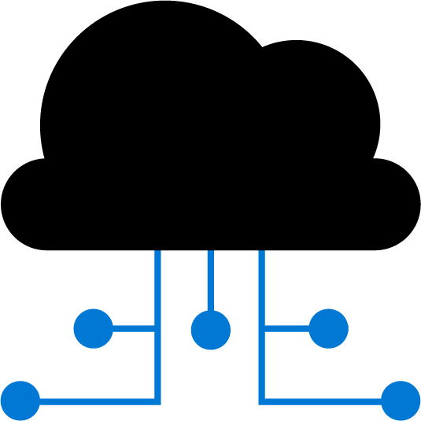

Explore Azure Pipelines and Visual Designer
Configure your pipelines with the Visual Designer
Continuous Integration
Continuous Deployment
Edit Code
Push to code repo
Build tasks
Test tasks
Create artifact
Release tasks
Deploy to target
Create and configure your build and release pipelines.
Push your code to your version control repository.
The build creates an artifact that’s used by the rest of your pipeline.
Your code is now updated, built, tested, and packaged.
Often referred to as “Classic Pipelines”

Slide 21

Describe Azure Pipelines and YAML
Configure your pipelines in a YAML file that exists alongside your code
Edit Code
Edit YAML file
Push to code repo
Azure Pipelines
Deploy to target
Configure Azure Pipelines to use your Git repo.
Edit your Azure-pipelines.yml file to define your build.
Push your code to your version control repository.
Your code is now updated, built, tested, and packaged.
While more code-oriented, defining pipelines using YAML is preferred

Slide 22
Module 04: Design and implement a pipeline strategy

Slide 23
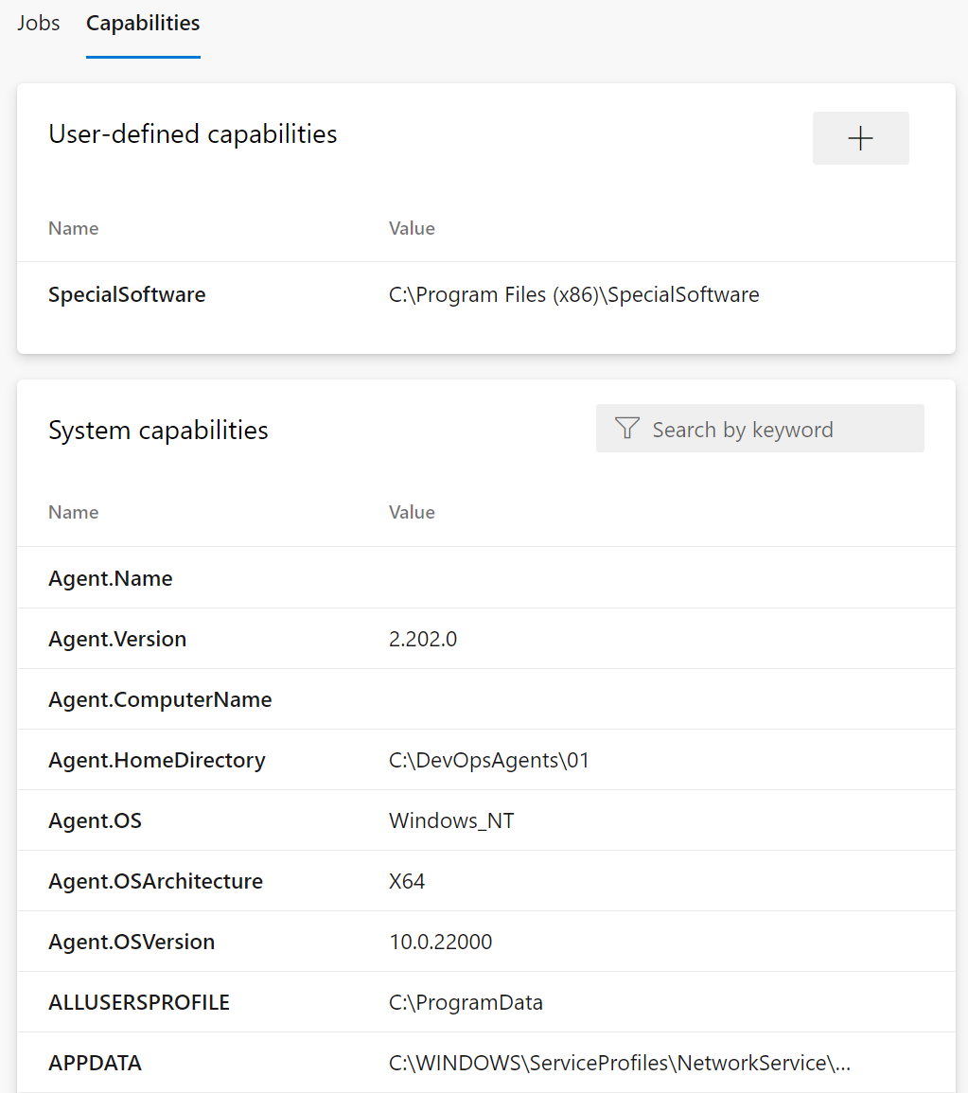
Configure agent demands
User-defined capabilities
System capabilities
Agents can have different authorization and timeout settings.
Notes:
For more information, you can see: Capabilities - https://docs.microsoft.com/azure/devops/pipelines/agents/agents

Slide 24
Explore multi-configuration and multi-agent
1
Multi-configuration: Run the same set of tasks on multiple configurations:
Run the release once with configuration setting A on WebApp A and setting B for WebApp B
Deploy to different geographic regions
2
Multi-agent: Run the same set of tasks on multiple agents using the specified number of agents:
Deploy same bits to a farm of servers

Slide 25

Implement multi-job builds
Adding multiple jobs to a pipeline lets you:
1
Break your pipeline into sections that need different agent pools, or self-hosted agents
2
Publish artifacts in one job and consume them in one or more subsequent jobs
3
Build faster by running multiple jobs in parallel
4
Enable conditional execution of tasks
You can configure the number of parallel jobs
Notes:
✔️ You can define a build as a collection of jobs, rather than as a single job. Each job consumes one of these parallel jobs that runs on an agent. If there aren't enough parallel jobs available for your organization, the jobs will be queued and run sequentially.

Slide 26
Integrate GitHub repos and Azure Pipelines
Key considerations
Method | Key Actions
GitHub App authentication | Supports GitHub Checks and does not rely on personal GitHub identities
OAuth | Suitable when working with personal GitHub accounts
GitHub personal access token (PAT) | Relies on personal GitHub identity but its permissions can be configured granularly. Subject to expiration.
Naming convention
User management
Azure Pipelines permissions
Notes:
Only the first pipeline created for a single repository across multiple Azure DevOps organizations can be automatically triggered by GitHub commits or pull requests. The remaining pipelines require manual or scheduled triggers.

Slide 27
Design and implement a comprehensive testing strategy
Key considerations
Assessment and planning
Tools and frameworks selection
Test automation
Continuous integration (CI)
Continuous deployment (CD)
Monitoring and feedback
Documentation and training
Test Types
Unit testing | Integration testing
Functional testing | Smoke testing
Load testing | UI testing
Stress testing | Performance testing
Chaos testing | Penetration testing
Security testing | End-to-end testing
Notes:
Different tests can be performed in a single environment or across multiple environments, depending on the testing goals and criteria. Some tests, such as chaos testing and load testing, should be performed together to provide meaningful results

Slide 28
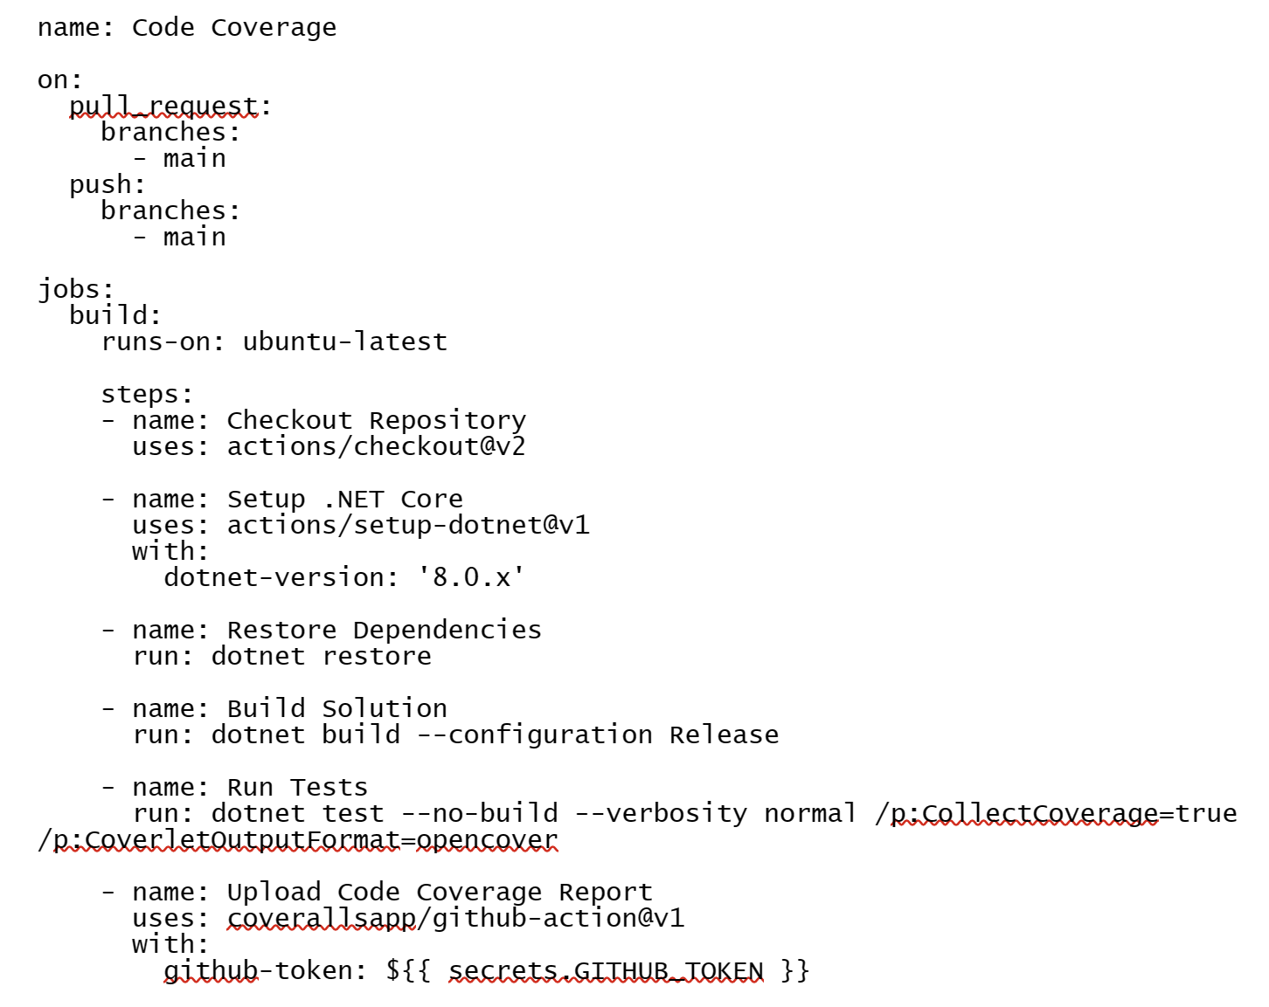
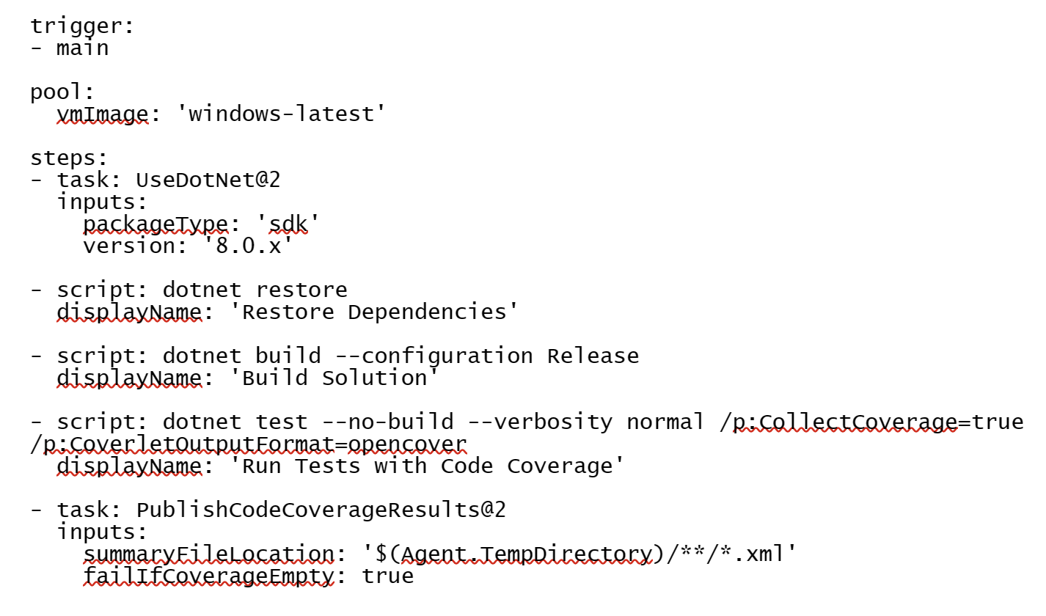
Implement code coverage and show in the pipeline
Azure DevOps implementation
GitHub Actions implementation
Set up test and coverage tools
Configure Azure Pipelines
Add code coverage tasks
Publish code coverage reports
Set up test and coverage tools
Create GitHub Actions workflow
Configure workflow steps

Slide 29
Explore source control types supported by Azure Pipelines
Repository types supported:
Repository Type | Azure Pipelines (YAML) | Azure Pipelines (Classic Editor)
Azure Repos Git | Yes | Yes
Azure Repos TFVC | No | Yes
Other Git (Generic) | No | Yes
GitHub | Yes | Yes
GitHub Enterprise Server | Yes | Yes
Subversion | No | Yes

Slide 30
Module 05: Integrate with Azure Pipelines

Slide 31
Describe the anatomy of a pipeline
1
Name – Though often this is skipped (if it is skipped, a date-based name is generated automatically)
2
Trigger – More on triggers later, but without an explicitly trigger, there’s an implicit “trigger on every commit to any path from any branch in this repo”
3
Variables – These are “inline” variables (more on other types of variables later)
4
Job – Every pipeline must have at least one job
5
Pool – You configure which pool (queue) the job must run on
6
Checkout – The “checkout: Self” tells the job which repository (or repositories if there are multiple checkouts) to checkout for this job
7
Steps – The actual tasks that need to be executed: in this case a “script” task (script is an alias) that can run inline scripts

Slide 32
Understand the pipeline structure
1
Pipeline – One or more stages that describe a CI/CD process
2
Stage – Collection of related jobs
3
Job – Collection of steps run by an agent on a server
4
Step – Linear sequence of operations that make up a job
5
Tasks – Building blocks of a pipeline
Notes:
In case you want to review the pipeline structure.

Slide 33
Detail YAML templates
Azure Pipelines supports 4 kinds of templates:
1
Stage
2
Job
3
Step
4
Variable

Slide 34
Explore YAML resources
resources:
pipelines: [ pipeline ]
repositories: [ repository ]
containers: [ container ]
Pipelines
Repositories
Containers
resources:
pipelines:
- pipeline: MyAppA
source: MyCIPipelineA
- pipeline: MyAppB
source: MyCIPipelineB
trigger: true
- pipeline: MyAppC
source: MyCIPipelineC
branch: releases/M174
version: 20230709.2
trigger:
branches:
include:
- main
- releases/*
exclude:
- users/*

Slide 35
Use multiple repositories in your pipeline
1
Common for utilities used across more than one pipeline
2
Add additional checkout steps
3
Was not supported in earlier versions and artifacts were used as a workaround
4
Some pipelines might not need any repository
5
Build and validate pull requests and commits to your GitHub repository with Azure Pipelines
Notes:
Make sure you mention GitHub and its integration with Azure Pipelines for CI and Pull Request triggers.

Slide 36
Migrate a pipeline from classic to YAML in Azure Pipelines
Feature | Key Considerations | Limitations
Export to YAML | For build pipelines. Support for most tasks, triggers, jobs and options | Does not include variables and time zone translation
View YAML | For release pipelines. Can generate the YAML code for individual tasks, which can be used to create the YAML pipeline | The code does not include values of the individual task properties but substitutes them with variables
Task Assistant | Helps with creating and modifying YAML steps by providing a graphical interface, autocomplete suggestions, inline documentation, validation, and marketplace integration | N/A

Slide 37
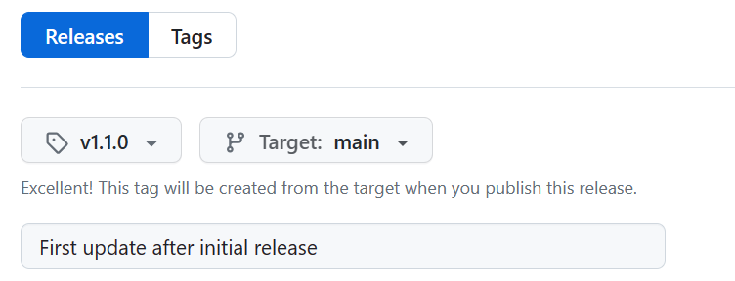
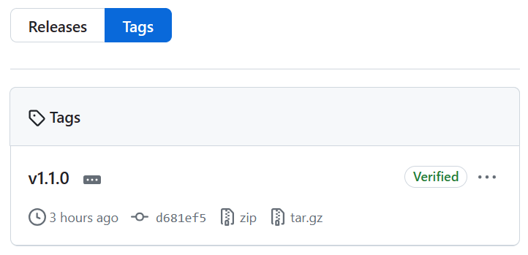
Mark releases with Git tags
Releases are based on Git tags
Mark a specific point in repository history
Tags are viewed in the repository history

Slide 38
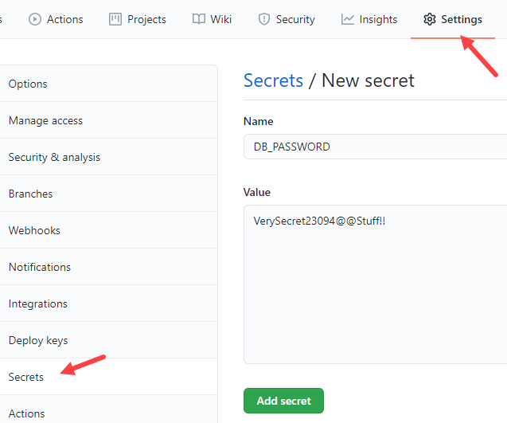
Create encrypted secrets
Like environment variable but encrypted
Created at repository or organization level
Created/assigned in the GitHub UI

Slide 39
Use secrets in a workflow
steps: actions/upload-artifact
- name: Test Database Connectivity
with:
db_username: ${{ secrets.DBUserName }}
db_password: ${{ secrets.DBPassword }}
Secrets not automatically passed to runners
Can be passed as inputs or as environment variables
Avoid passing secrets in command-line arguments
steps:
- shell: pwsh
env:
DB_PASSWORD: ${{ secrets. DBPassword }}
run: | db_test "$env.DB_PASSWORD"

